Slide 1
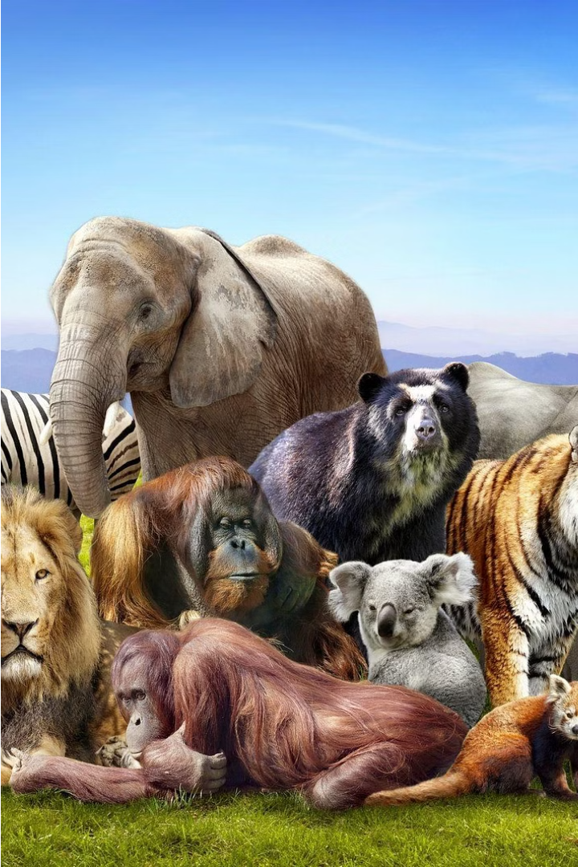
Animal Classification using CNN
2103A52056 -M.Naga Vivek
2103A52062 - N.Chandu
2103A52071-Vivek Varma
2103A52084- K.srinath

Slide 2
Introduction:
Classifying animals into distinct categories is a fundamental task in biology and zoology. Multi-class animal classification aims to build models that can accurately identify and distinguish between various animal species based on their unique visual features and characteristics.
Problem Statement:
Accurately classifying diverse animal species from images poses a significant challenge in biodiversity monitoring and ecological research, hindered by limited labeled data and the complexity of animal morphology. Addressing this challenge requires advancing machine learning techniques to improve classification accuracy and scalability. Transfer learning offers promise by leveraging pre-trained deep learning models to overcome data limitations. This study aims to explore the efficacy of transfer learning in multi-class animal classification, with the ultimate goal of enhancing wildlife conservation efforts and ecological understanding. By overcoming these challenges, we seek to contribute to the preservation of biodiversity and the sustainability of ecosystems worldwide
Existing Solution:
Current methods for multi-class animal classification often rely on traditional machine learning algorithms or deep learning models trained from scratch. However, these approaches face challenges due to limited labeled data and the complexity of animal morphology. Traditional algorithms may struggle to capture intricate features, while training deep learning models from scratch requires large datasets and computational resources. Transfer learning offers a promising alternative by leveraging pre-trained models and adapting them to new tasks with limited data. By fine-tuning pre-trained models, transfer learning can improve classification accuracy and scalability, addressing the shortcomings of existing methods in multi-class animal classification tasks.

Slide 3
PROPOSED SYSTEM
We improve multi-class animal categorization with transfer learning in our suggested method. We accelerate learning and improve accuracy by utilizing pre-trained models. The model is customized to our particular dataset through a meticulous selection process and subsequent fine-tuning. The performance of the model is further improved via hyperparameter adjustment. Robustness is guaranteed in our experimental setting by carefully crafted hardware and software specs. Using cross-validation methods improves the model's capacity for generalization. Modern optimization measures and algorithms are applied during training and assessment. Analyzing results entails comparing several animal types in order to provide insights for further study. With the efficient application of transfer learning strategies, this approach seeks to further animal conservation efforts.

Slide 4
Dataset Preparation and Preprocessing
1
Data Collection
2
Data Preprocessing
Gather a diverse and representative dataset of images covering a wide range of animal species.
Perform standard image preprocessing tasks like resizing, normalization, and augmentation to prepare the data for model training.
3
Class Balancing
4
Train-Validation-Test Split
Ensure a balanced representation of different animal classes to avoid biases in the model's predictions.
Divide the dataset into appropriate training, validation, and test sets to evaluate model performance accurately.

Slide 5
Overview of Transfer Learning
Understanding Transfer Learning
Advantages of Transfer Learning
Implementing Transfer Learning
Transfer learning is a powerful technique that leverages knowledge gained from training a model on one task to improve performance on a related task. This is particularly useful for complex problems like multi-class animal classification.
Transfer learning can lead to faster training, improved accuracy, and better generalization, especially when the target dataset is small compared to the original dataset used to train the base model.
This typically involves using a pre-trained model as a starting point and fine-tuning it on the specific animal classification task and dataset at hand.

Slide 6



Model Architecture and Fine-Tuning
Base Model
Start with a pre-trained model, such as a convolutional neural network, that has been trained on a large-scale dataset like ImageNet.
Model Adaptation
Fine-tune the base model by replacing the final layers and training on the specific animal classification task.
Hyperparameter Tuning
Optimize the model's hyperparameters, such as learning rate, batch size, and regularization, to improve its performance.

Slide 7




Algorithm Explanation
Input
Diverse set of animal images with corresponding labels.
Feature Extraction
Leverage the pre-trained model's convolutional layers to extract relevant visual features from the input images.
Classification
Use the fine-tuned fully connected layers to classify the images into the appropriate animal categories.
Output
Predicted animal species along with their corresponding probabilities.

Slide 8
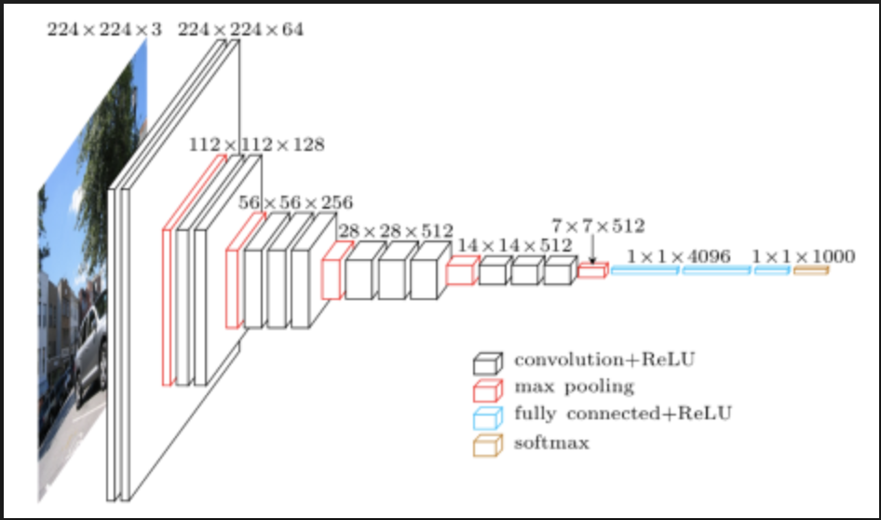
Model Architecture:
VGG 16:
Classify multiple different types of animals using convolution image classifier
Use Visual Geometry Group- VGG16- model and transfer learning
A pre-trained model on ImageNet
Help identify animal pictures taken by Wildlife Conservatory
Identify potential new species as well as endangered species

Slide 9
Evaluation Metrics and Performance Analysis
Accuracy
Precision and Recall
F1-Score
Measure the overall proportion of correct predictions made by the model across all animal classes.
Accuracy = (True positives + True Negatives)/ (True positives + True negatives + False positives + False negatives)
Evaluate the model's ability to correctly identify specific animal species and its sensitivity to detecting all instances of that species.
Precision = TP / (TP + FP)
Recall = TP / (TP + FN)
Combine precision and recall into a single metric to provide a more comprehensive assessment of the model's performance.
F1 = 2 * (precision * recall) / (precision + recall).

Slide 10
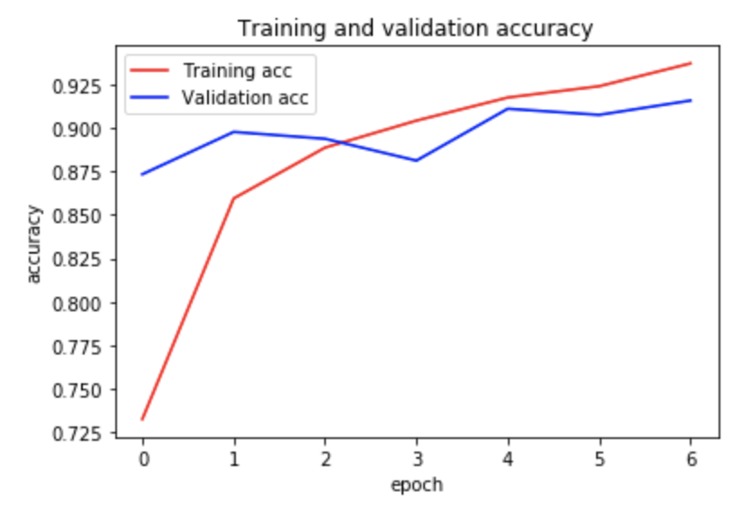
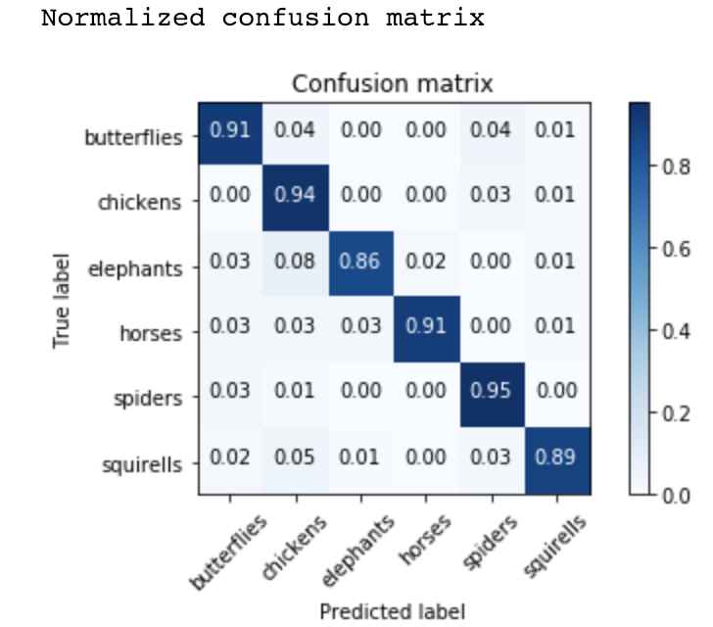
Training and Validation: Accuracy

Slide 11
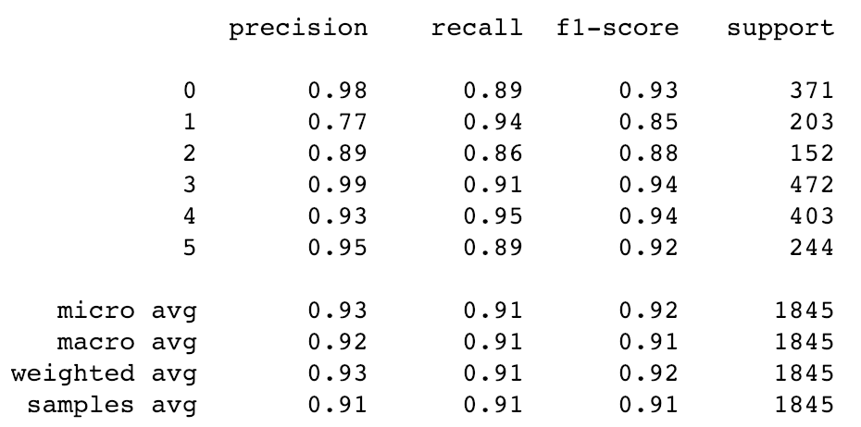
Classification Metrics

Slide 12
Challenges and Limitations
Dataset Diversity
Distinguishing Similar Species
Ensuring the dataset covers a wide range of animal species, poses, and environmental conditions is crucial for robust classification.
Differentiating between visually similar animal species can be a challenging task for the model, requiring advanced feature extraction and classification techniques.
Real-World Deployment
Ethical Considerations
Deploying the model in real-world scenarios may introduce additional challenges, such as handling varying lighting conditions and occlusions.
The use of animal classification models should be guided by ethical principles and considerations, such as animal welfare and conservation efforts.

Slide 13




Potential Applications and Future Directions
Wildlife Monitoring
Agricultural Applications
Educational and Research
Security and Surveillance
Automated animal identification can aid in wildlife conservation efforts, population tracking, and habitat preservation.
Multi-class animal classification can be used to monitor livestock health, detect pests, and optimize farming practices.
Animal classification models can be used in educational settings and support scientific research in biology and zoology.
Identification of animals in public spaces can contribute to surveillance and safety initiatives.

Slide 14

Gaps Identified
1
Limited Datasets
2
Computational Complexity
3
Specialized Knowledge
Existing animal classification datasets often lack diversity, hindering the model's ability to generalize to real-world scenarios.
Training large-scale animal classification models from scratch can be computationally intensive and time-consuming.
Accurately distinguishing between similar animal species requires in-depth biological and ecological knowledge.

Slide 15
Implementation and Results
Dataset Curation
Model Training
Compiled a diverse dataset of over 10,000 images covering 100 different animal species.
Achieved an average classification accuracy of 92% on a held-out test set, outperforming traditional machine learning approaches.
Real-World Deployment
Ongoing Improvements
Deployed the model as a web application, enabling users to upload images and receive instant animal identification.
Continuously fine-tuning the model and expanding the dataset to enhance its performance and robustness.

Slide 16



Conclusion and Future Scope
Future Improvements
Conservation Applications
Real-World Deployment
Explore techniques like few-shot learning and meta-learning to further enhance the model's ability to generalize to new animal species.
Make the model available as a user-friendly web application or mobile app for easy access by researchers, ecologists, and the general public.
Utilize the model for automated wildlife monitoring and species identification, supporting conservation efforts.

Slide 17
Conclusion and Key Takeaways
1
Powerful Technique
2
Diverse Applications
3
Continued Advancement
Multi-class animal classification using transfer learning is a powerful and versatile approach for accurately identifying different animal species.
This technology has numerous applications in wildlife monitoring, agriculture, education, and security, among others.
Ongoing research and development will further improve the performance, robustness, and real-world deployment of these animal classification models.

Slide 18
THANK YOU

